Slide 1
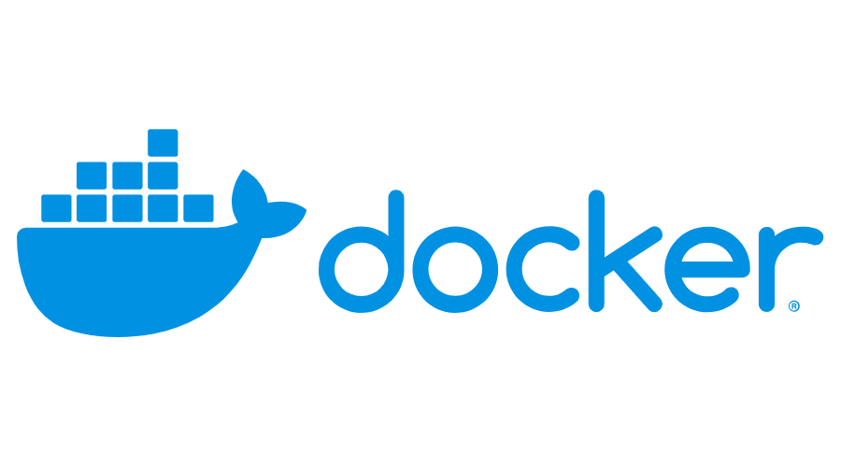
Domain – Security
Created by :Rajagopal K
670334

Slide 2
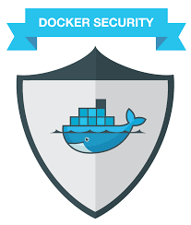
Docker Security Challenges :
The risk of privilege escalation via containers.
An attack originating from one container that compromises data or resources used by a different container.
One container seizes control of all available system resources in order to stop other containers from operating properly.
Insecure or invalidated app images.

Slide 3

Container Security and Risks :
Unsecured Communication and Unrestricted Network Traffic
Unrestricted access of process and files
Kernel level threats
Inconsistent update and patching of docker containers
Unverified docker images

Slide 4
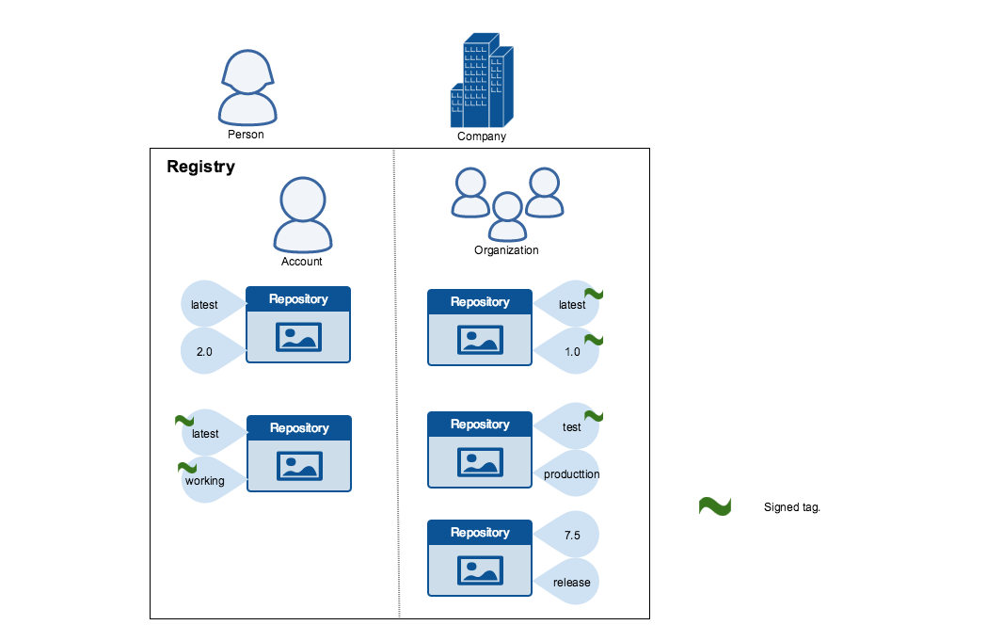
Content trust in Docker :
Docker Content Trust (DCT) provides the ability to use digital signatures for data sent to and received from remote Docker registries.
These signatures allow client-side or runtime verification of the integrity and publisher of specific image tags.
Through DCT, image publishers can sign their images and image consumers can ensure that the images they use are signed.
Publishers could be be individuals or organizations manually signing their content or automated software supply chains signing content as part of their release process.

Slide 5
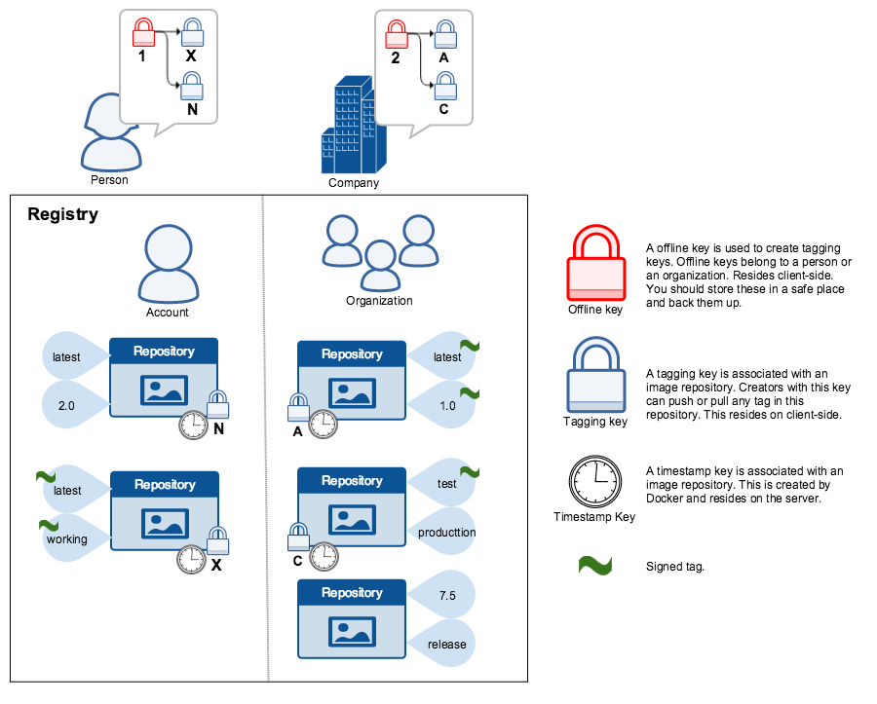
Docker Content Trust Keys :
Trust for an image tag is managed through the use of signing keys. A key set is created when an operation using DCT is first invoked. A key set consists of the following classes of keys:
an offline key that is the root of DCT for an image tag
repository or tagging keys that sign tags
server-managed keys such as the timestamp key, which provides freshness security guarantees for your repository

Slide 6
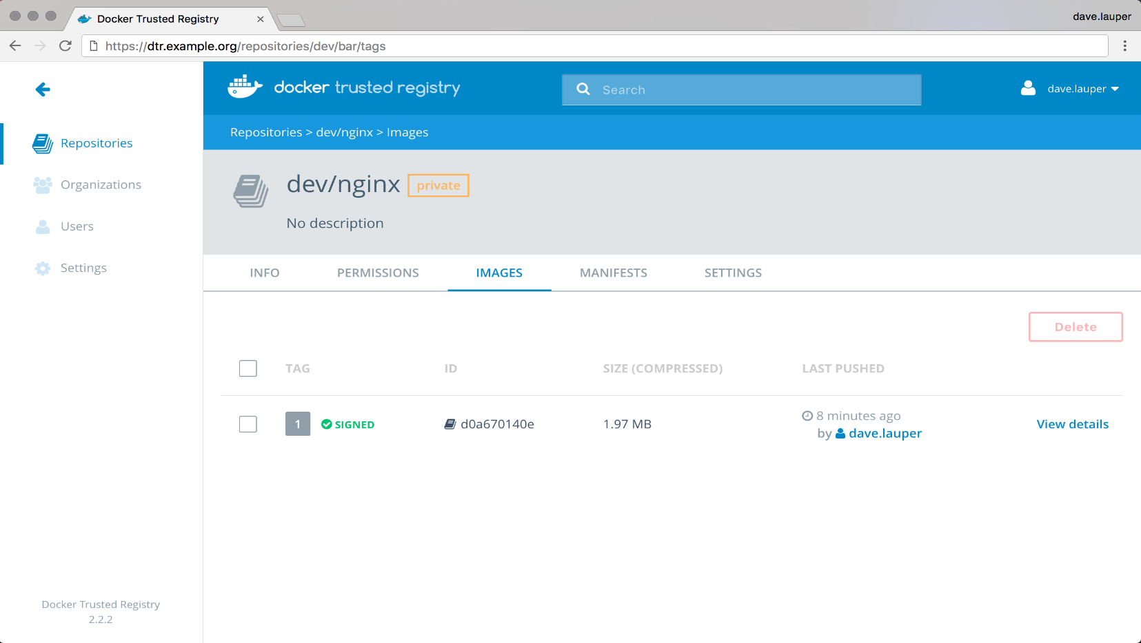
Sign an image :
Image is signed using docker content trust.
CMD:
export DOCKER_CONTENT_TRUST=1
docker push <dtr-domain>/<repository>/<image>:<tag>

Slide 7
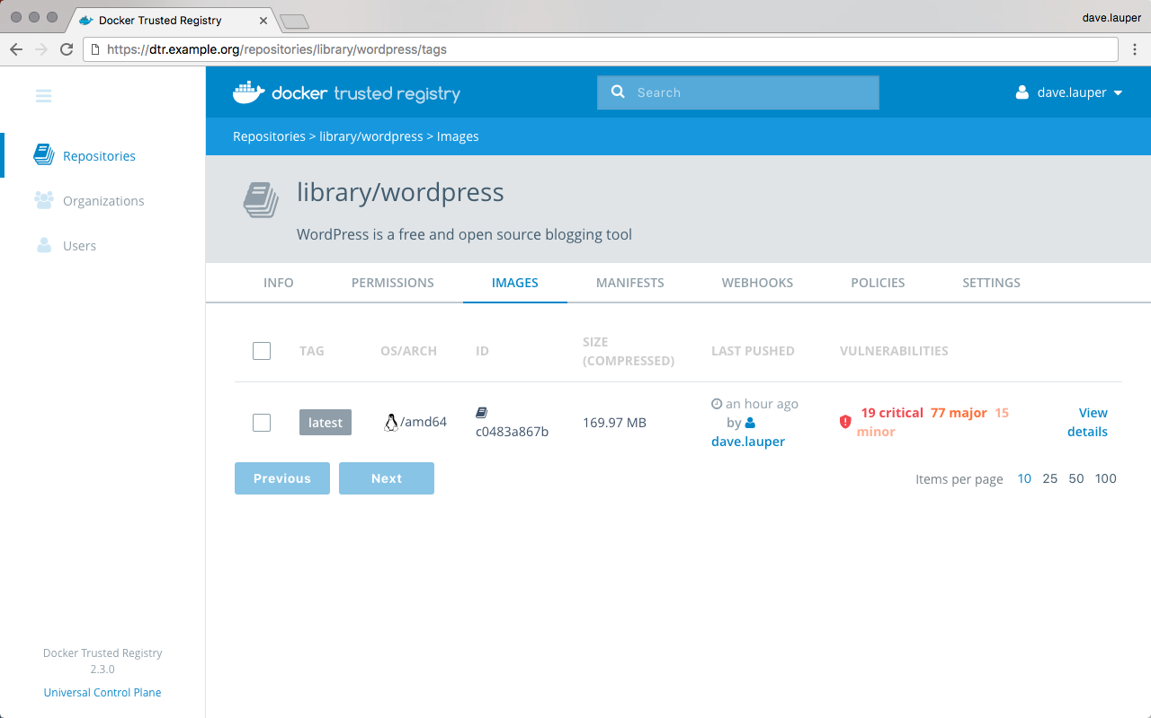
Scan images for vulnerabilities :
Docker Trusted Registry can scan images in your repositories to verify that they are free from known security vulnerabilities or exposures, using Docker Security Scanning.
Docker Security Scan Process :
Scanner performs a binary scan on each layer of the image, identifies the software components in each layer.
A binary scan evaluates the components on a bit-by-bit level, so vulnerable components are discovered.
The scan then compares the SHA of each component against the US National Vulnerability Database that is installed on your DTR instance.

Slide 8
REFERENCE LINKS
Describe the process of signing an image
Demonstrate that an image passes a security scan
Enable Docker Content Trust
Configure RBAC in UCP
Integrate UCP with LDAP AD
Demonstrate creation of UCP client bundles
Describe default engine security
Describe swarm default security
Describe MTLS
Identity roles
Describe the difference between UCP workers and managers
Describe process to use external certificates with UCP and DTR

Slide 9
THANK YOU

